Slide 1
A practical introduction to neural networks
Part 2: Convolutional neural networks
Ian Durbach
University of St Andrews / University of Cape Town
indurbach@gmail.com

Slide 2
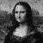
Image classification
Row 1
Row 2
Row 3
middle ages
1
early renaissance
50
1
50
late renaissance

Slide 3
A filter, when convolved with an image, creates a new image.
The new image highlights some features and dampens others.
Each convolutional layer consists of several filters.
Works on any sequential data, not just images

Slide 4
CNNs
Generally will be input layer then
a sequence of convolutions and a max pooling,
more convolutions and a max pooling,
then end with fully connected layers.

Slide 5
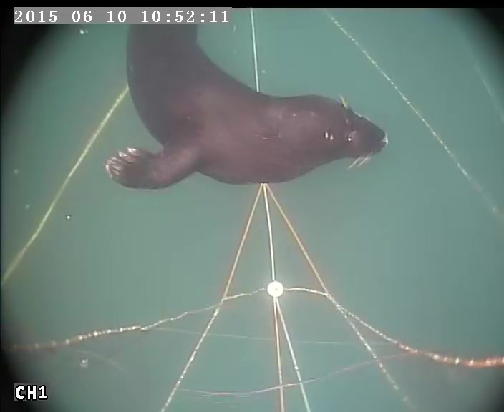
Option 1: start smaller
Pr(S)
Option 2: transfer learning
Pr(S)

